Slide 1
Business use case for Mall app

Slide 2
Problem
Retail Space Property Owners suffer from loss of tenants and unable to collect rent
Shop Owners suffer from profitability loss because customers are moving to online shopping and E-commerce

Slide 3
Hypothesis
Profitability problems of shop owners and landlords in the retail space can be solved by increasing the revenue of shop owners collectively
Assumptions
Retail space shop owners and landlords are in the shopping mall/commercial hub space
Notes:
To tackle the problem statement, my initial working hypothesis is X. With this hypothesis in mind, I have made a few assumptions in order to reducing the problem boundary to be able to dive deeper into the problem. With that in mind I took the liberty to analyse the issue using a profitability framework

Slide 4
Profitability Model of Landlord
Profit
Revenue
Cost
Average Sales Price
Rent
Rent ↑ occupancy rate ↓
×
Volume
Occupancy rate
( Occupied outlets/ Available outlets )
Fixed Cost
- Maintenance Cost
Variable Cost
- Utilities
Demand
Profitability of shop owners
Notes:
Using a top-down approach, we first take a look at the retail space owner’s profitability model.

Slide 5
Profitability Model of Shop Owner Collective
Profit
Revenue
Cost
Average Sales Price
×
Average Cost Price
Volume
×
Volume
Bundling
Promotions
Point Rewards System
Foot Traffic
Customer UX
Store Locator
Parking
Auxillary Services
Events
Dependent on businesses’ business model

Slide 6
Features (Average Sales Price)
Bundling
E.g. Spend RM100 in Shop A to get 20% off ala carte items in Shop B
Show bundles and promotions (below) in app
Promotions
Discount coupons, new releases
Point Reward System
Point collection every time money is spent – Redemption of goods with points collected
User register themselves for point collection

Slide 7
Features (Volume)
Store Locator
Digital interface in app
Parking Assist
QR code pillar car tracking / Parking space locator
Auxiliary Services
Wheelchair/Buggy ride/Child service information
Event
Event information

Slide 8
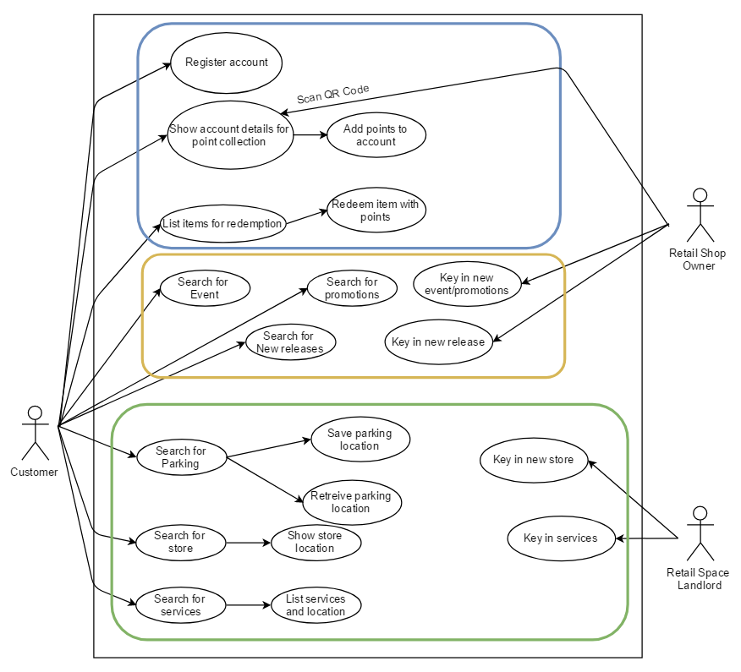
Use cases
Point reward system
Promotion and rewards
Location Service

Slide 9
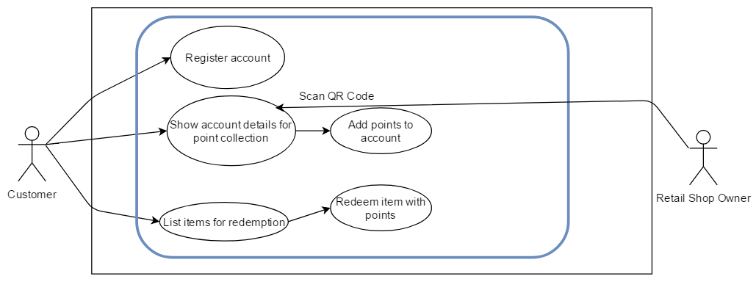
Use case - Point Reward System

Slide 10
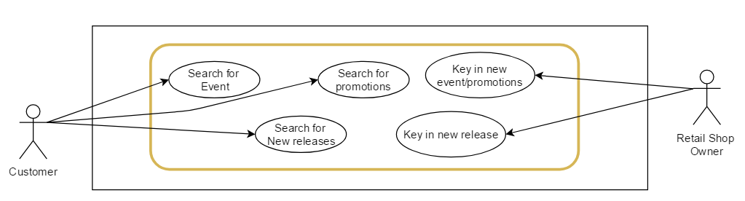
Use case – Events and Promotions

Slide 11
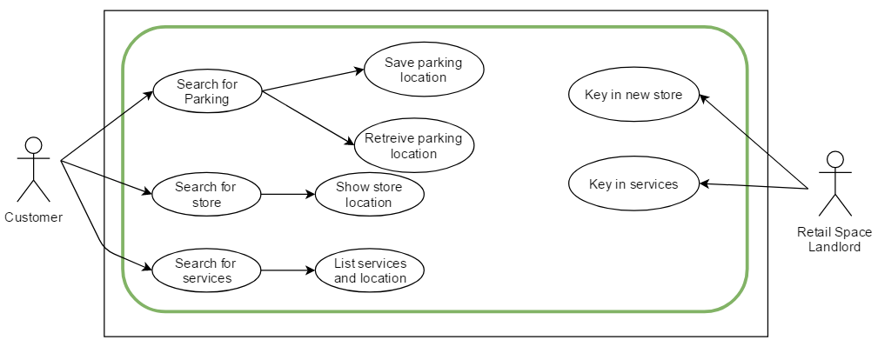
Use case – Location and Services

Slide 12
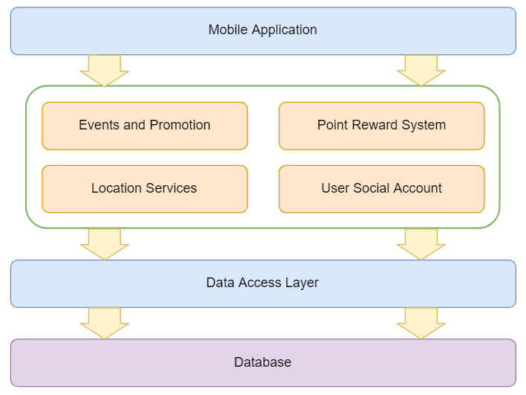
Software Architecture Diagram

Slide 13
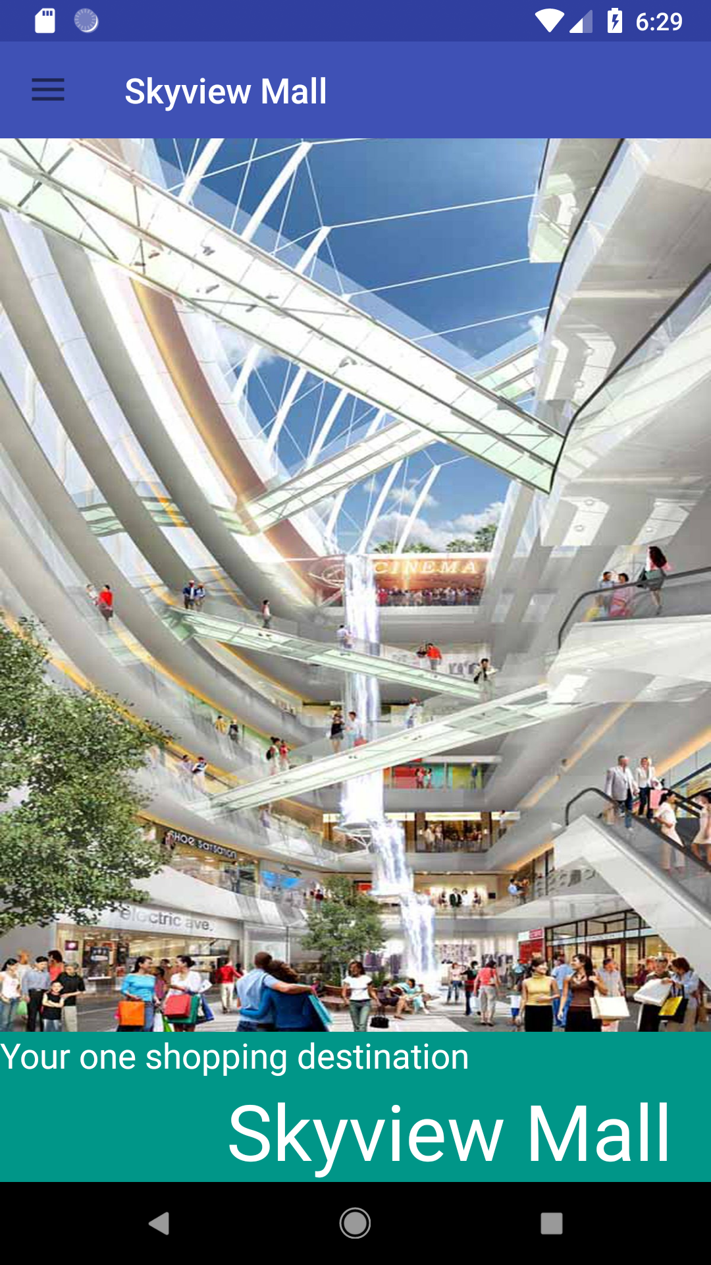
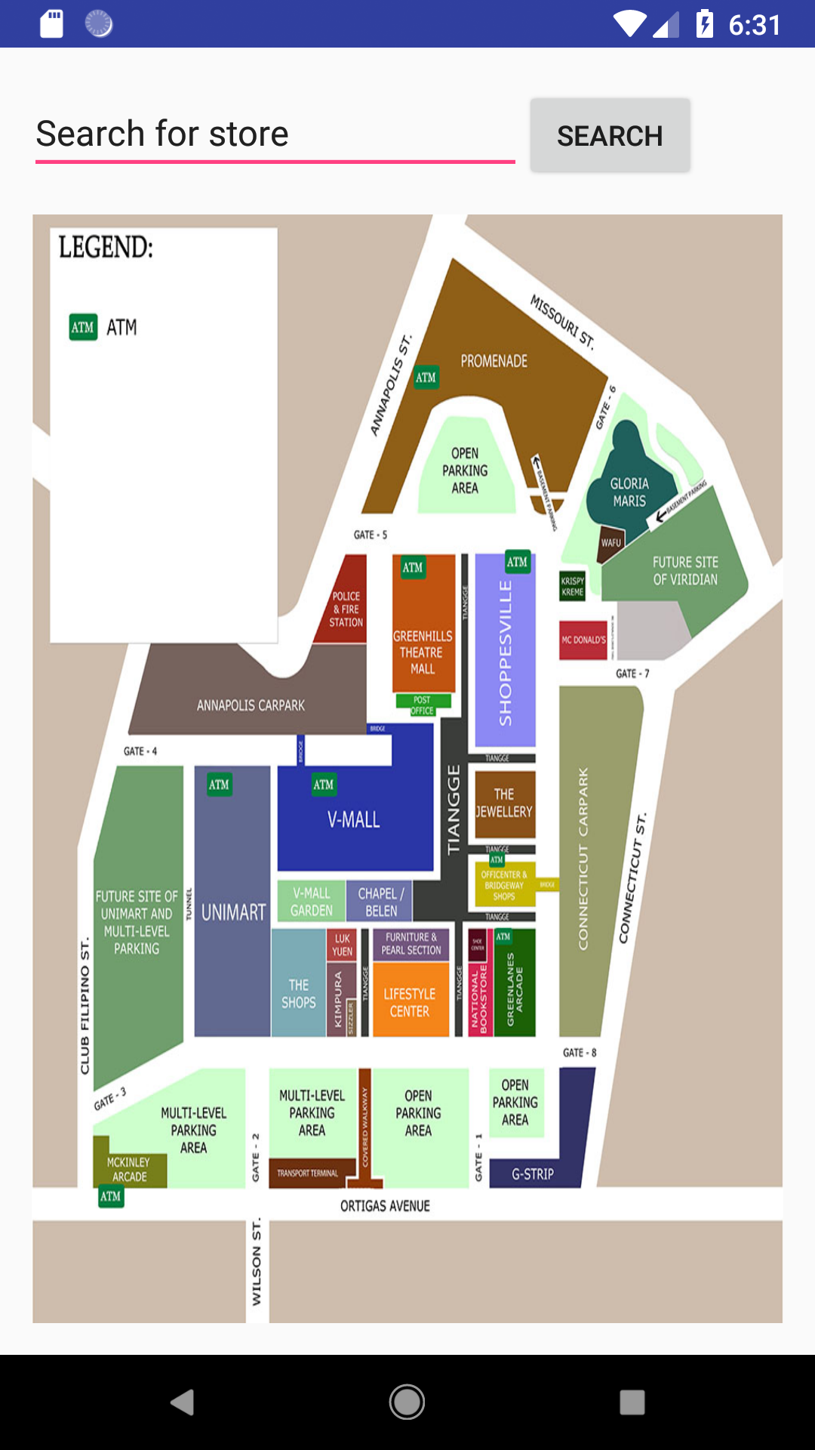
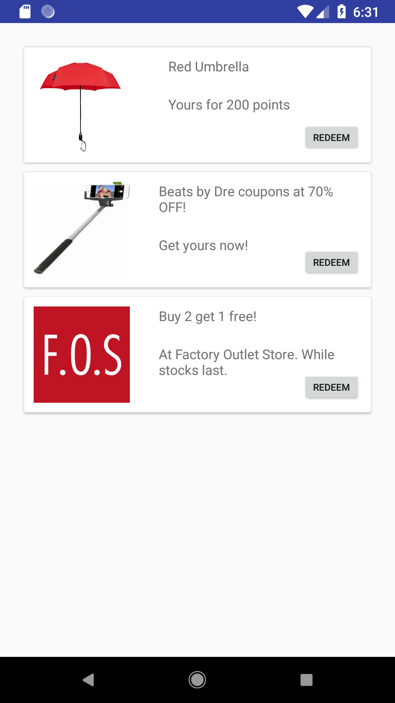
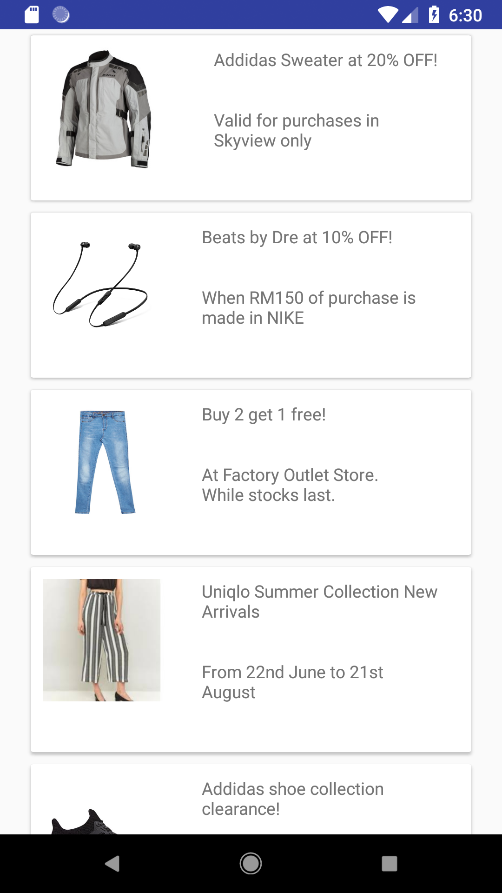
App Showcase

Slide 14
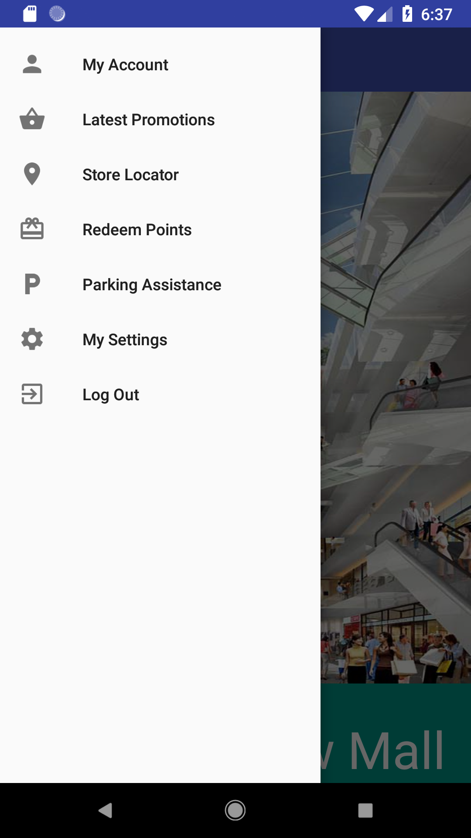
App Showcase
Main Menu

Slide 15
App Showcase
Main Menu

Slide 16
App Showcase
Rewards and Promotions

Slide 17
App Showcase
Rewards and Promotions

Slide 18
App Showcase
Rewards and Promotions

Slide 19
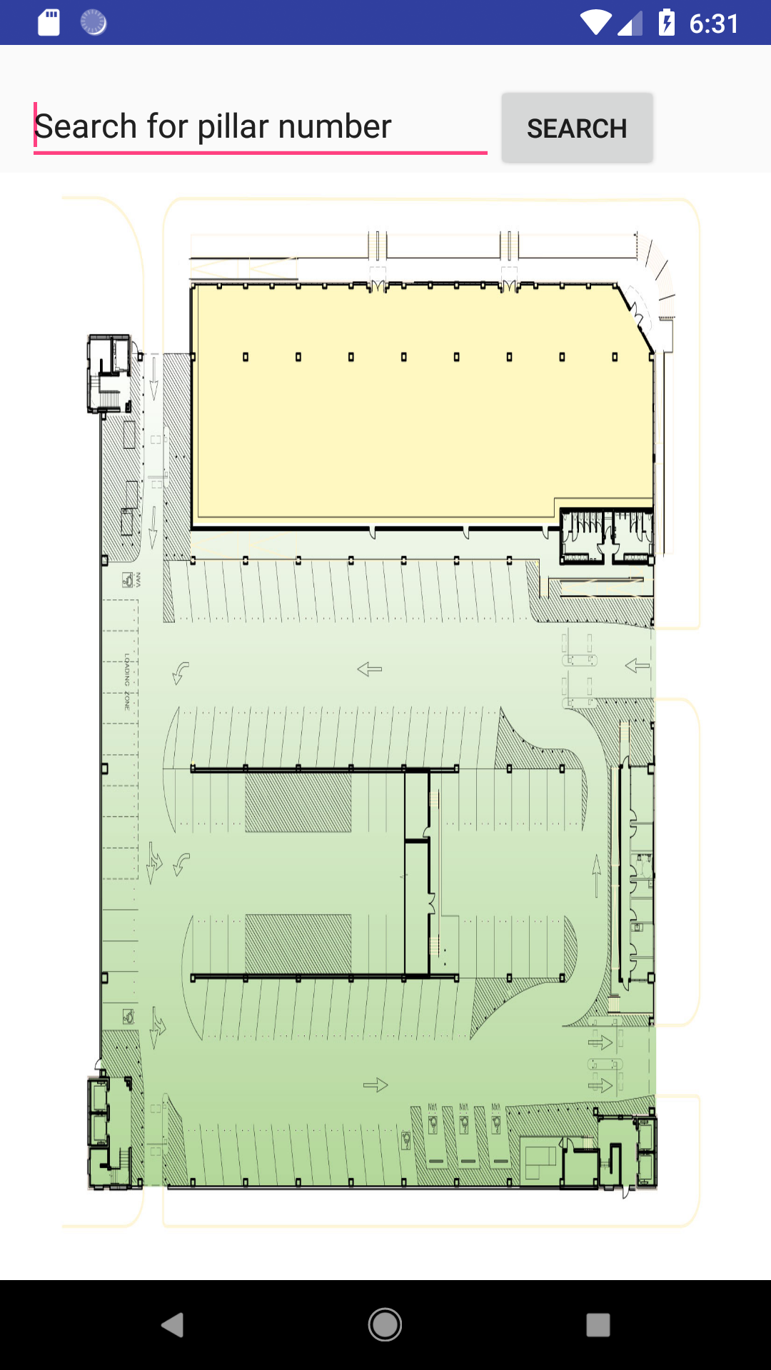
App Showcase
Location Services
Store Locator

Slide 20
App Showcase
Location Services
Parking Locator

Slide 21
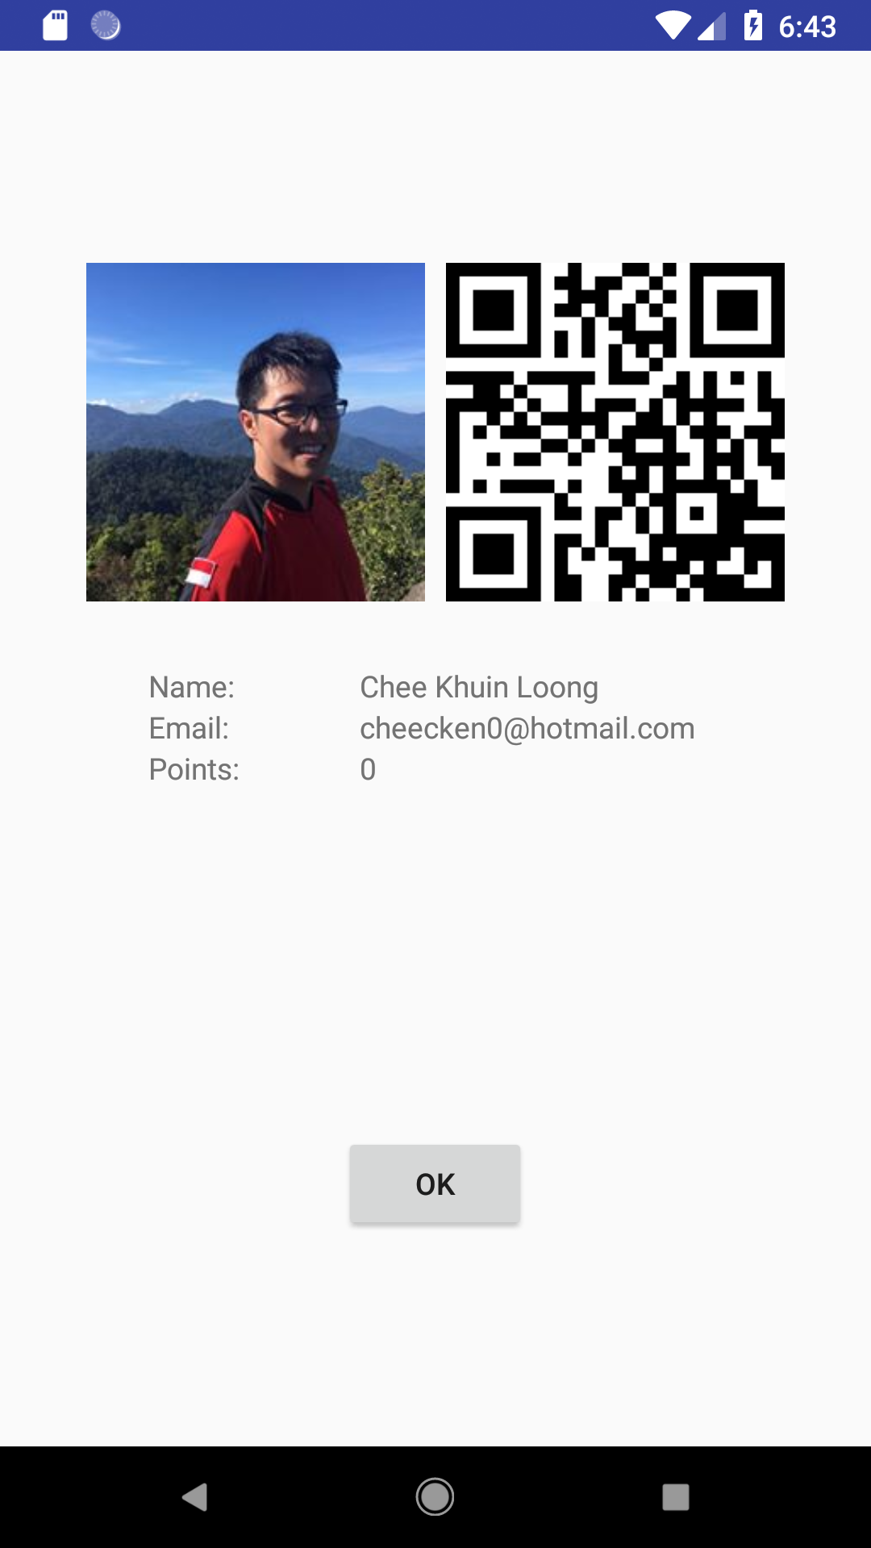
App Showcase
Point Reward System
User Page

Slide 22
App Showcase
Point Reward System
Redemption

Slide 23
App Showcase
Point Reward System
Redemption

